Slide 1
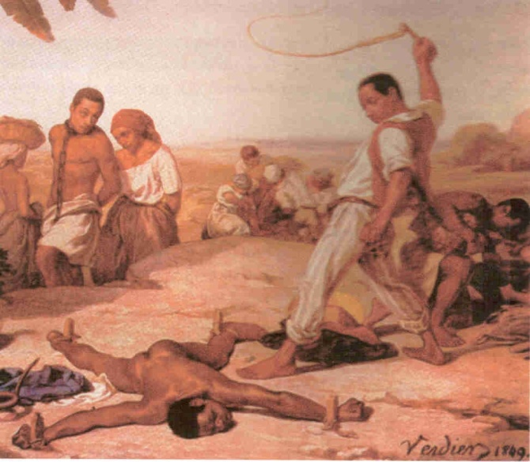
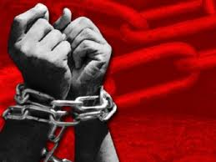
workshop: slavery presentation`s title : Slavery before and now
ISHA New Year Seminar 2011 , Belgrade
Imelda Dimitrova Vladeva, ISHA Sofia –
University “Saint Clement of Ohrid”

Slide 2
Purpose
Slavery refers to a condition in which individuals are owned by others, who control where they live and at what they work. Slavery had previously existed throughout history, in many times and most places.
The main purpose of this presentation is to show brief history of ancient slavery and modern slavery. In the end will be discovered the differences and similities between them.

Slide 3
Content:
The slavery before
Origin of slavery
Ancient slavery
Slavery in Greece
Slavery in Rome
Slavery in Africa
The slavery now
Slavery in the west Indies- 18c.
Early opponents of African slavery in England and America
Political history of slavery – compromises of 1850
The idea about slavery
19th- 20th century
The slavery – comparision, summary and implications

Slide 4
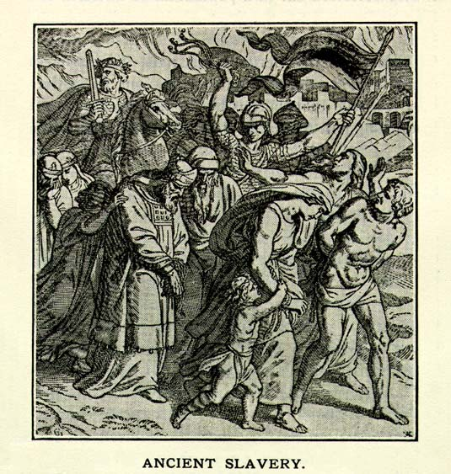
The slavery before
Origin of slavery
Ancient slavery
Early existence of slavery in the world
The jaractice of reducing prisoners of war to the condition of slaves existed both among the eastern nations and the people of the west ; for as the Helots became the slaves of the Spartans merely from the right of conquest, so prisoners of war were reduced to the same situation by the other inhabitants of Greece. The Romans, also, were actuated by the same principle.
“By the civil law the power of making slaves is esteemed a right of nations, and follows, as a natural consequence of captivity in war." - Justinian
We discover that the existence of Slavery is to be found in the almost incessant wars which were carried on in the early periods of the world, between tribes and nations, in which the prisoners taken were either slain or reduced to slavery.
Establishing it for the first time was made by the Jewish law. There were various modes by which the Hebrews might be reduced to servitude.

Slide 5
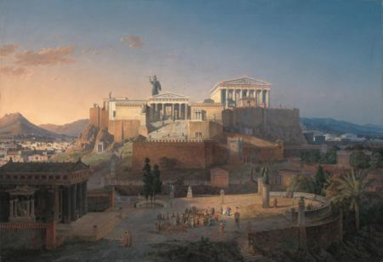
Slavery in Greece
Early existence of slavery in Greece
The various states of Greece had different codes of laws, but in all of them the slaves were a majority of the people. The ancient Greeks had many words to describe slaves Homer, Hesiod and Theognis of Megara - the slave was called δμώς / dmôs in other words, property. The most common word is δοῦλος / doûlos, used in opposition to "free man" (ἐλεύθερος /eleútheros). The verb δουλεὐω (which survives in modern Greek, meaning work) can be used metaphorically for other forms of dominion.
Probable origin of slavery
Slaves were present in the Mycenaen civilization. There is no continuity between the Mycenaean era and the time of Homer. In Works and days (8th century BC), Hesiod owns numerous dmôes,although their status is unclear. Chios, was the first city to organize a slave trade, 6th century.

Slide 6
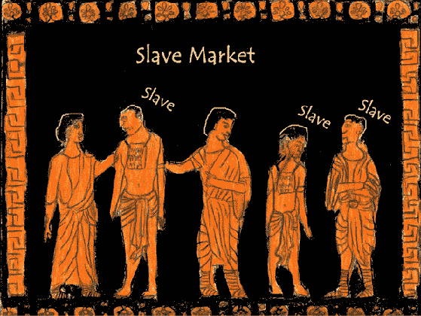
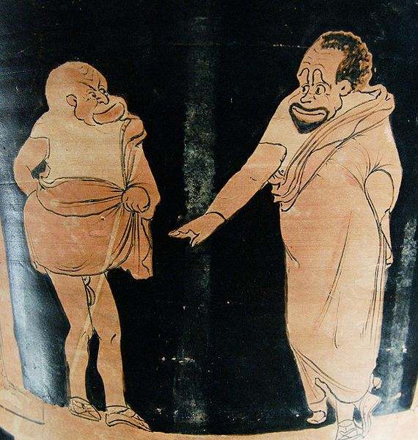
Examples in history of whole cities and states being reduced to slavery
Examples occur in antiquity of whole cities and states being at once subjected to servitude.
The citizens of Miletos, for example were carried into Persia, as were those also of other places. A similar fate overtook the inhabitants of Thebes, who were sold into slavery by Alexander.

Slide 7
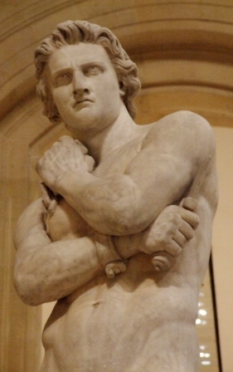
Slavery in Rome
Slavery under the kings and in the early ages of Republic
SLAVES existed at Rome in
the earliest times of which
we have any record ; but
they do not appear to have
been numerous under the
kings and in the earliest ages of
the Republic. The different
trades and the mechanic arts were
chiefly carried on by the clients
of the patricians.
Spartacus – brief history
Spartacus (: Σπάρτακος, Spártakos; Spartacus) (c. 109–71 BCE) was a famous leader of the slaves in the Third Servile war, a major slave uprising against the Roman Republic.
Spartacus's struggle, often interpreted as an example of oppressed
people fighting for their freedom against a slave-owning oligarhy.

Slide 8
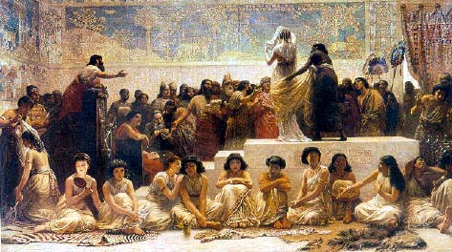
Effects of Christianity on their condition
In the early years of Christianity, slavery was a normal feature of the economy and society in the Roman Empire. Slavery was the bedrock of the Roman and World economy.
Most slaves were employed in domestic service in households and likely had an easier life than slaves working the land, or in mines or on ships.
Nevertheless, early Christianity rarely criticised the actual institution of slavery.
Slave-market

Slide 9
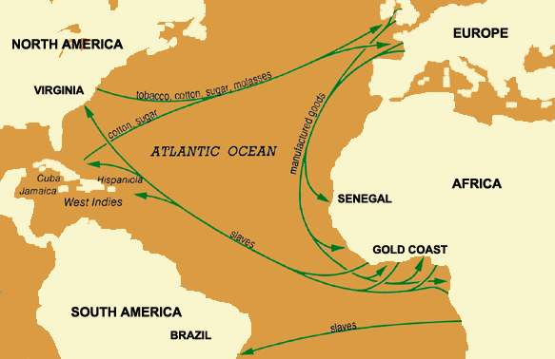
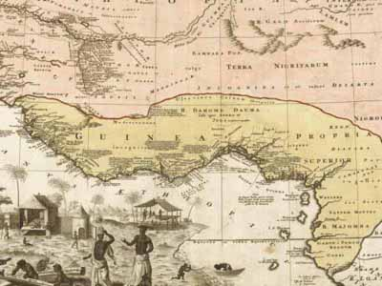
Slavery in Africa from fifteenth to the eighteenth century
First recognition of the slave-trade by the English government in 1562, reign of Elizabeth.
Slavery among the natives – the most important was that its founded for agricultural purpose. The first slaves worked over some of plantations in African land.
Portuguese establish the slave-trade was on the western coast
Portuguese establish the slave-trade on the western coast

Slide 10
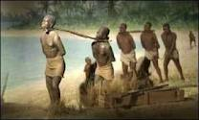
Slavery now Slavery in the west Indies 1750 to 1790
L a b o r of p l a n t a t I o n s l a v e s
1758 Slaves on William Byrd III's plantation on the
Bluestone River in Lunenburg County formed the
earliest black church in Virginia. (Colonial
Williamsburg's online Historical Almanack. Cultural
& Political Chronology 1750-1783)
Many Africans had little trouble adopting Christianity because it preached many of the same beliefs that were central to African religions--supreme being, creation myths, priest-healers, moral and ethical systems. Christianity's "life after death" was also attractive because it offered the promise that they would someday regain contact with their ancestors.
Washington was reelected president in 1792, and the following year the most divisive crisis arising out of the personal and political conflicts within his cabinet occurred. By the time the Revolution broke out in France, there was already a strong hostility to the trade among the educated elite. The Societe des Amis des Noirs was founded in 1788. Ending slavery and the slave trade thus became part of the Revolutionary agenda; and in 1794, after bitter disputes between the deputies, the National Convention finally outlawed the trade.

Slide 11
Early Opponents of African Slavery in England and America
Original draft of Declaration of Independence
The Declaration would have its most prominent influence on the debate over slavery] The contradiction between the claim that "all men are created equal" and the existence of American slavery attracted comment when the Declaration was first published.
First Society formed in America "for Promoting Abolition of Slavery

Slide 12
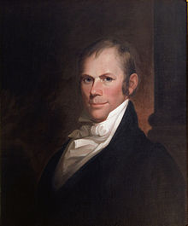
Political History of Slavery.—Compromises of 1850
Mr. Clay's propositions for arrangement of slavery controversy.—His resolutions
On January 29, 1850, Clay proposed a series of resolutions, what would widely be called the Compromise of 1850. While Clay originally intended the resolutions to be voted on separately, at the urging of southerners, Clay agreed to the creation of a Committee of Thirteen to consider the measures. The committee was formed on April 17. Clay on May 8 presented an omnibus bill linking all of the resolutions included:
Admission of California as a free state, ending the balance of free and slave states in the senate.
Organization of the Utah and New Mexico territories without any slavery provisions, giving the right to determine whether to allow slavery to the territorial populations.
Prohibition of the slave trade, not the ownership of slaves, in the District of Columbia]
A more stringent Fugitive Slave Act.[
Establishment of boundaries for the state of Texas in exchange for federal payment of Texas's ten million dollar debt.
A declaration by Congress that it did not have the authority to interfere with the interstate slave trade.[

Slide 13
The idea about slavery – 19-th -20th century. Modern form of slavery
Modern form of slavery concerned most psychological moments in live – like home violence, children violenced to work, freedom of speech etc.

Slide 14
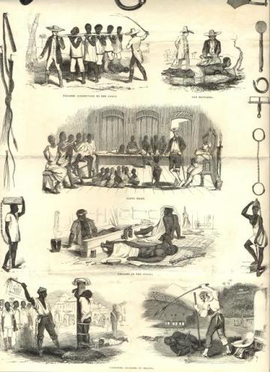
Comparision, summary and implications
VS

